Slide 1
Optimising Homepage Recipe Selection to Drive Traffic
A solution for Tasty Bytes

Slide 2
Business Overview
Founded in 2020.
For a monthly subscription, Tasty Bytes will provide families or individuals with a full meal plan.

Slide 3
Business Aims
Aim 1
Aim 2
Aim 3
Improve Homepage Recipe Selection Process:
Automate the selection by using ML model.
To increase website traffic and subscriptions.
Minimize the Chance of Showing Unpopular Recipes:
Reduces the risk of displaying unpopular recipes.
Prevent the loss of traffic and subscriptions.
Achieve 80% Accuracy in Predictions:
Accurately predict required recipes.
Requested by the product team.

Slide 4
Data
Columns:
recipe
calories
carbohydrate
sugar
protein
servings
category
high_traffic
947 rows and 8 columns in dataset.
This dataset provides nutritional and categorical information on various recipes, helping analyse nutritional values, and recipe popularity.
This data will be used to create the model to predict high_traffic for unseen data.
The data must be cleaned initially.

Slide 5
Data Validation
Missing Values
Mapping
Data Type
5% of entries had missing values in 4 columns, simultaneously. These are removed
40% of entries has a missing value for the high_traffic column. Filled with False
Certain values had to be mapped to be aligned with other data in the column.
Convert all columns to the required data type, like the category column should be categorical data type.
Notes:
Removed because only 5% Imputing values for four different columns could potentially distort the dataset and introduce bias.
The high_traffic column only contained True so its reasonable to assume that the entries should be categorised as low.

Slide 6
Key Findings from Exploratory Data Analysis

Slide 7
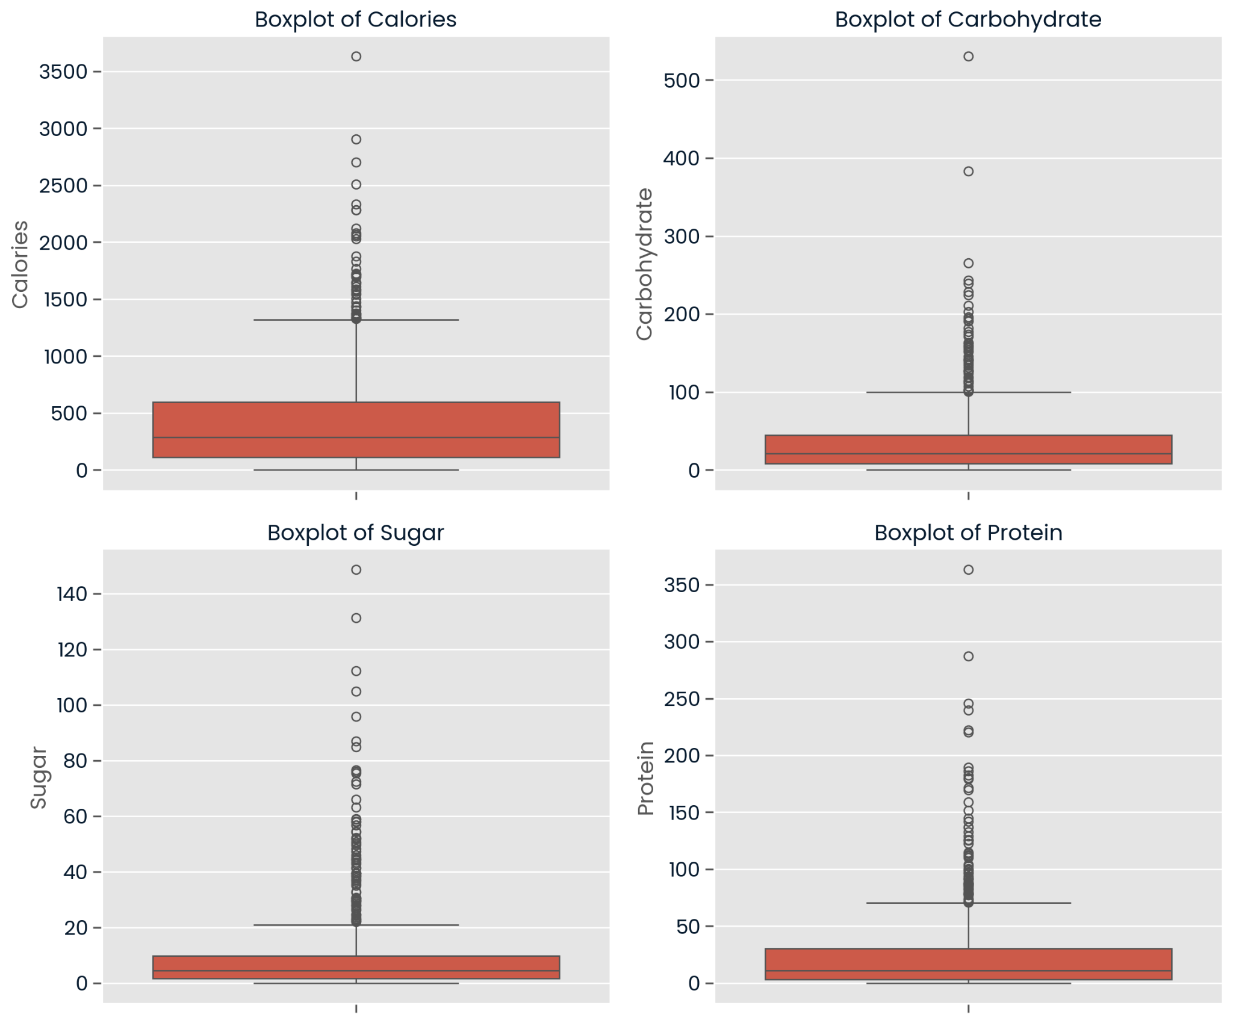
Outliers
Lots of outliers, but within reasonable range
Model used will need to consider the effect of outliers.
Notes:
as some models like Logistic Regression are more sensitive to outliers while models like Random Forest are more robust to outliers.

Slide 8
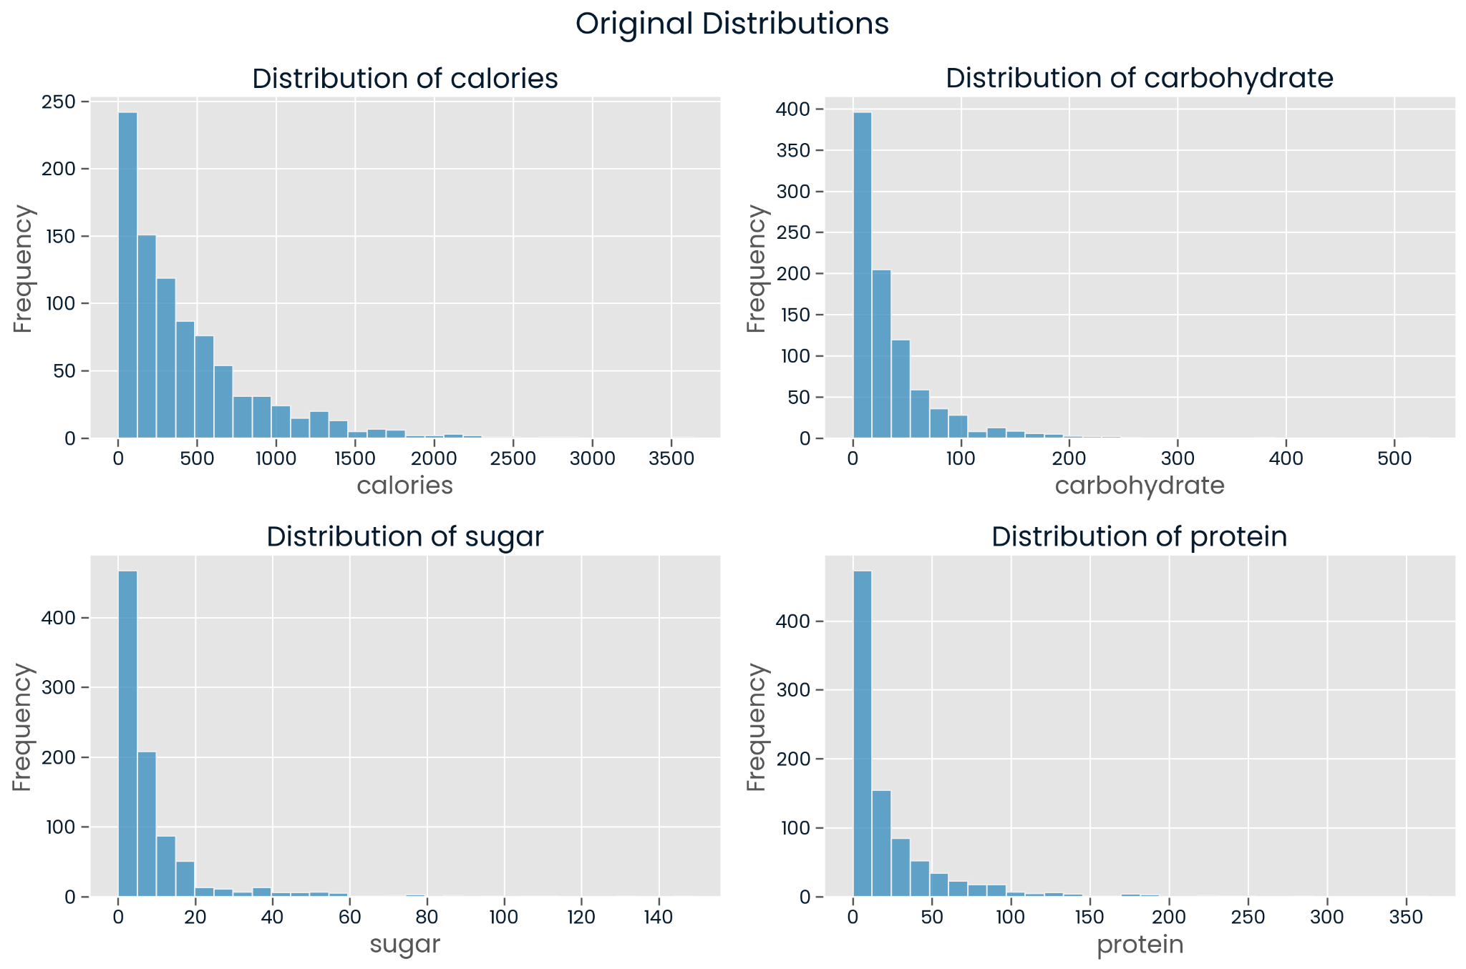
Distributions
Heavily right-skewed data.
ML models work best with normally distributed features

Slide 9
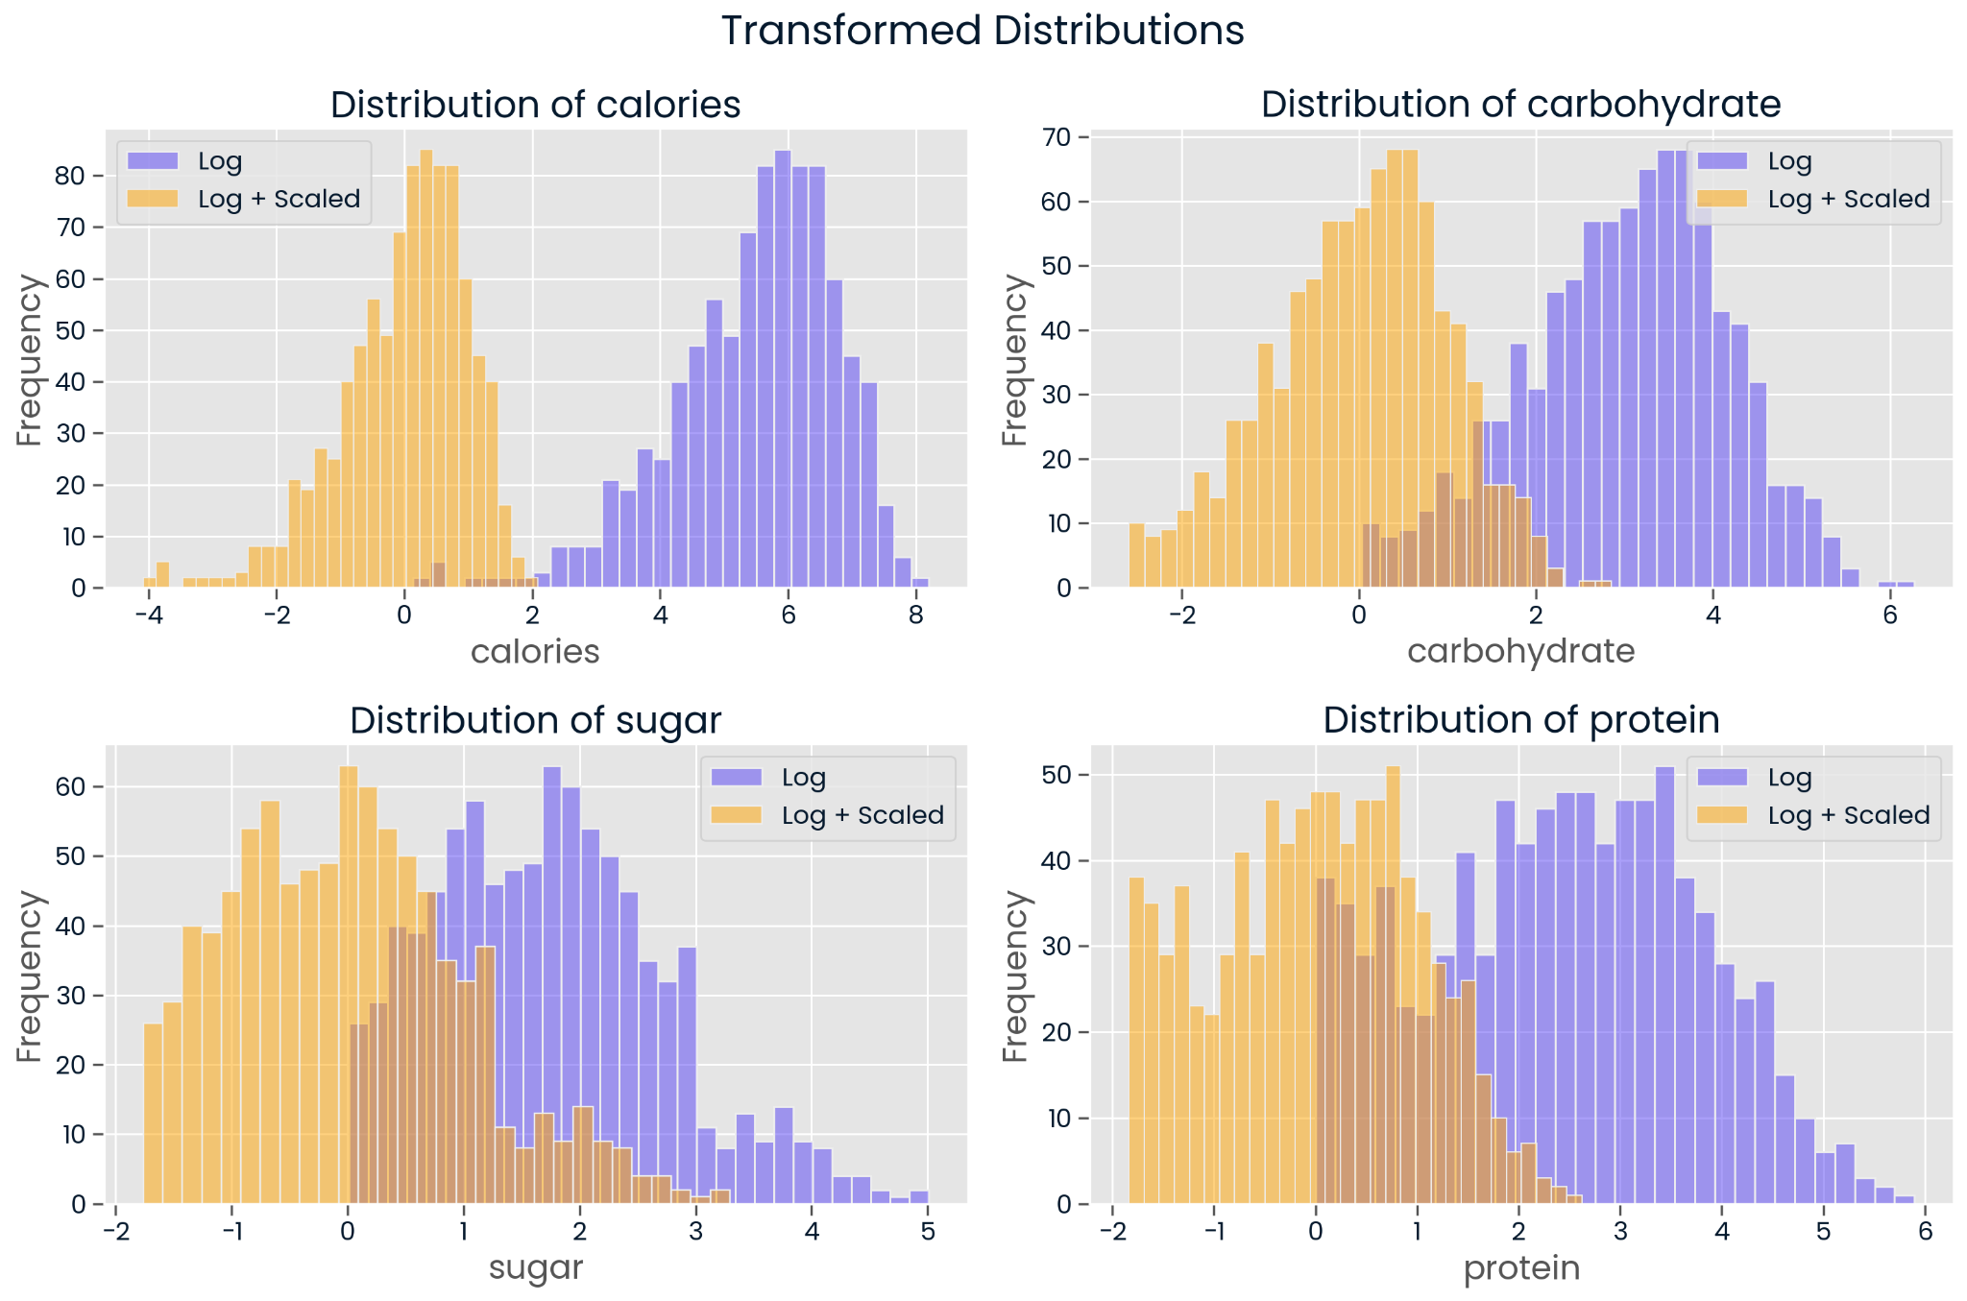
Transformed
Distributions
Log Transformation reduce the skewness.
StandardScaler to normalise the data with standard mean and variance

Slide 10
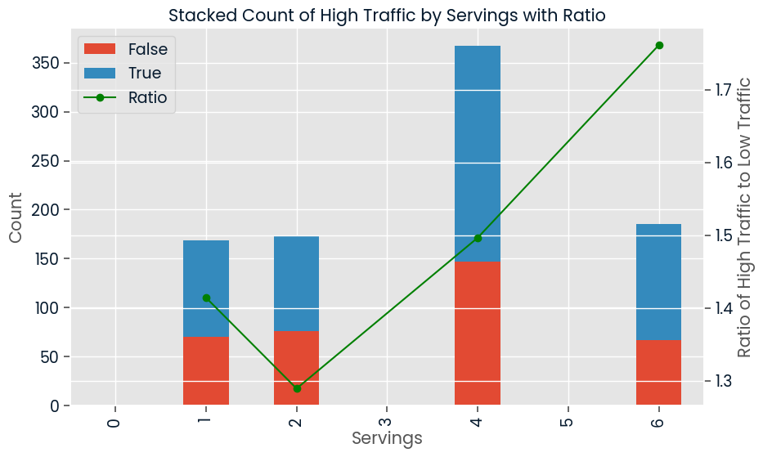
Serving-Target Variable Relationship
Barplot of servings grouped by high_traffic
The Ratios indicate a positive relationship
Could be used to identify target variable
Notes:
The higher the ratio the more likely entries with that particular serving size will be high Traffic

Slide 11
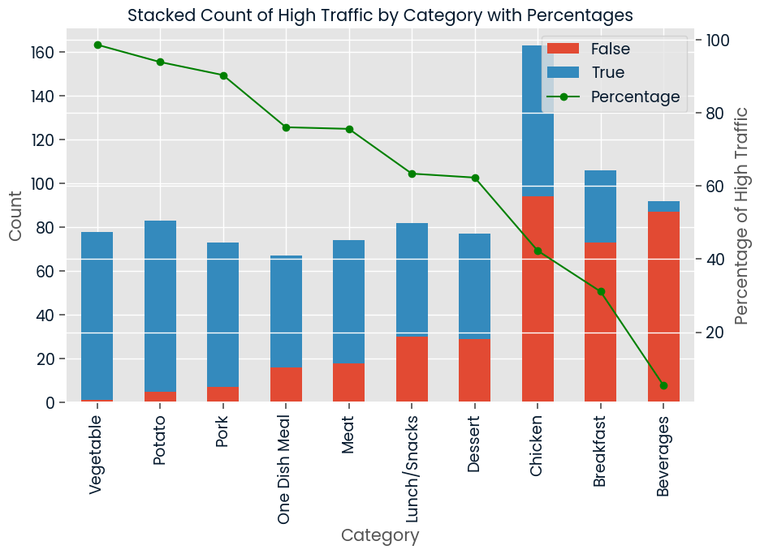
Category-Target Variable Relationship
Clear trend observed.
Features with extreme percentages can be used to predict target variable.
Vegetable, Potato, Pork, Beverages
Notes:
High percentage likely to be high_traffic while low percentages likely not to be.

Slide 12
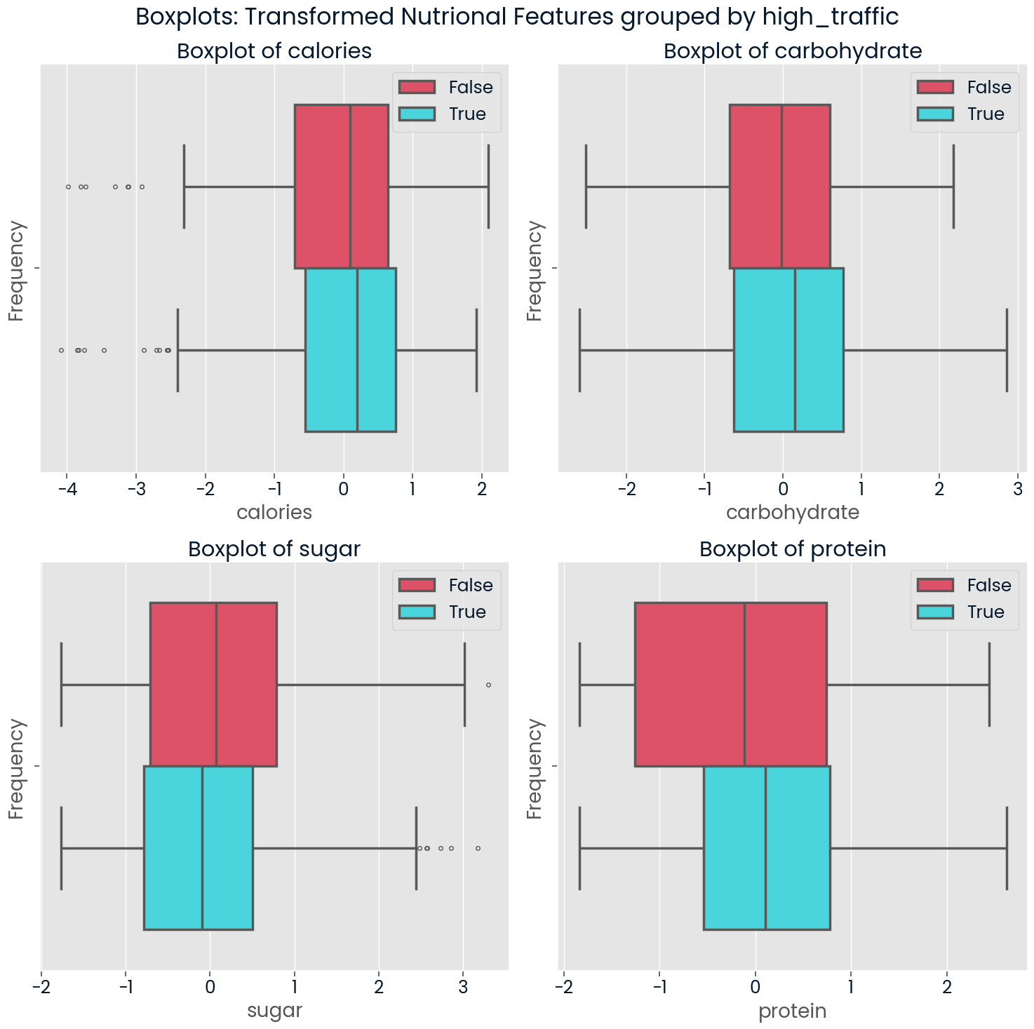
Nutritional Features and Target Variable Relationship
Boxplots show these nutritional features are not good indicators for the target variable.
Suggests the need for data engineering to improve these features.
Notes:
Boxplots for high_traffic data and low_traffic data are very similar. -> not good indicators

Slide 13
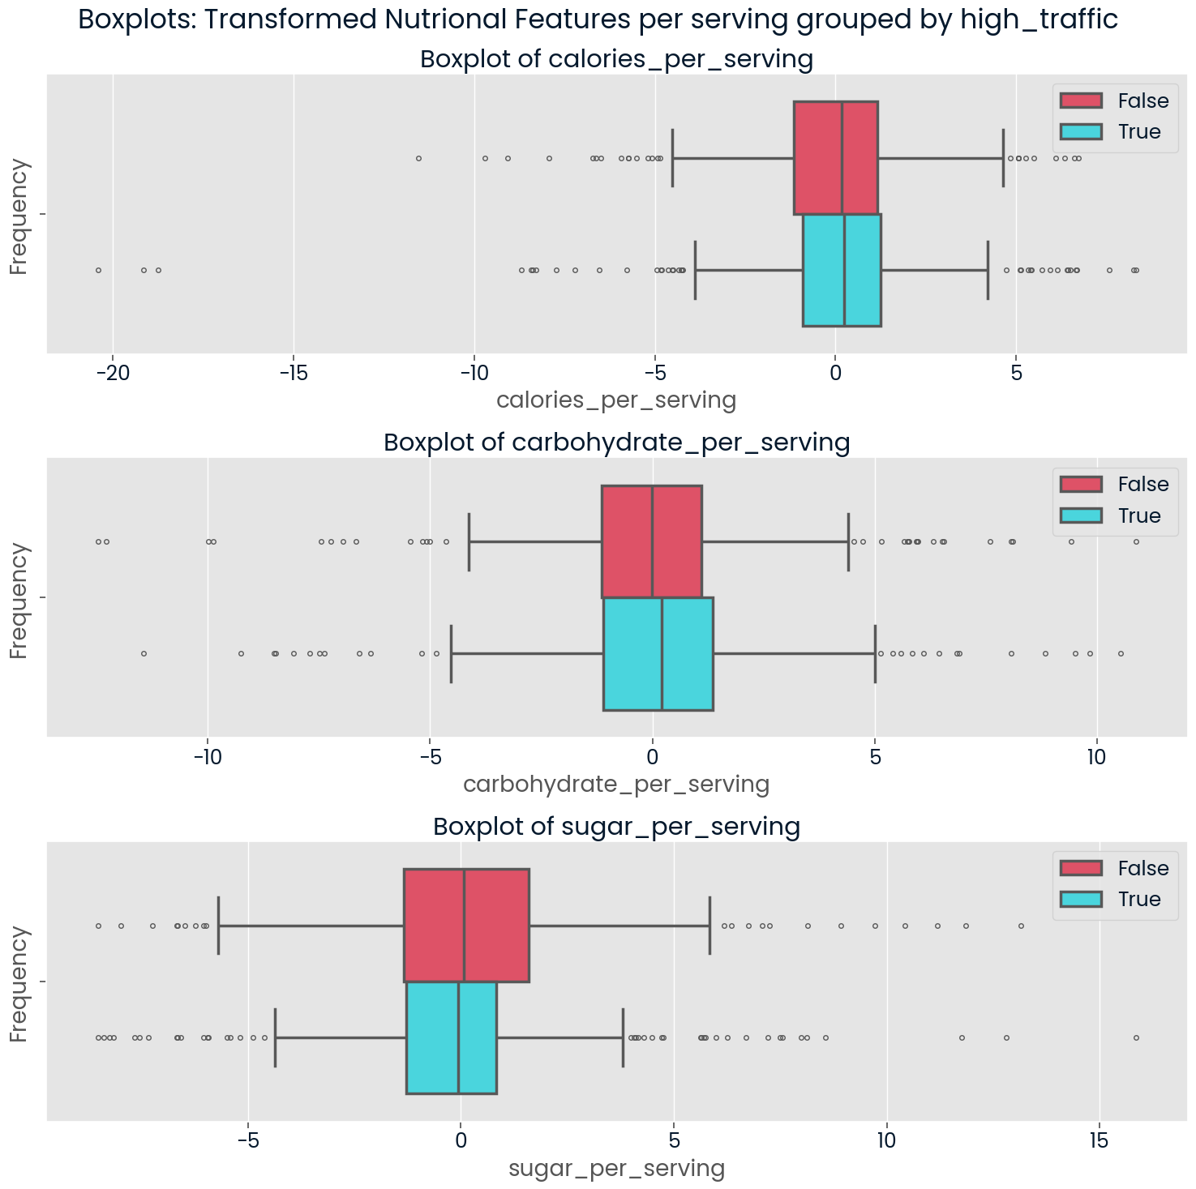
Feature Engineering
The previous boxplots and initial modelling suggests carbohydrates, sugar, and calories are not good indicators of the target variable.
New features were created to represent the nutritional features per serving.
Boxplots does show much improvement, but fitting with these features may result in a better model.

Slide 14
Model Development and Evaluation

Slide 15
Data Preprocessing
Transformation
Dummify Variables
Train Test Split
- Log and StandardScaler transformation previously described on the nutritional features.
- Convert the categorical data into binary columns using dummy variables.
- Model doesn’t work with categorical data.
- Split data into 80% train, and 20% test.
- Helps avoid overfitting, and allows for evaluation of the model on unseen data.
Notes:
Removed because only 5%Imputing values for four different columns could potentially distort the dataset and introduce bias.
The high_traffic column only contained True so its reasonable to assume that the entries should be categorised as low.

Slide 16
Modelling
The project is a classification model to predict a boolean target variable
They main metrics used to model is precision to minimise the chance of False Positives, as a low_traffic recipe on the home page will result in less traffic and subscriptions.
A secondary metric used is accuracy where the product team requires a model with an accuracy over 80%.

Slide 17
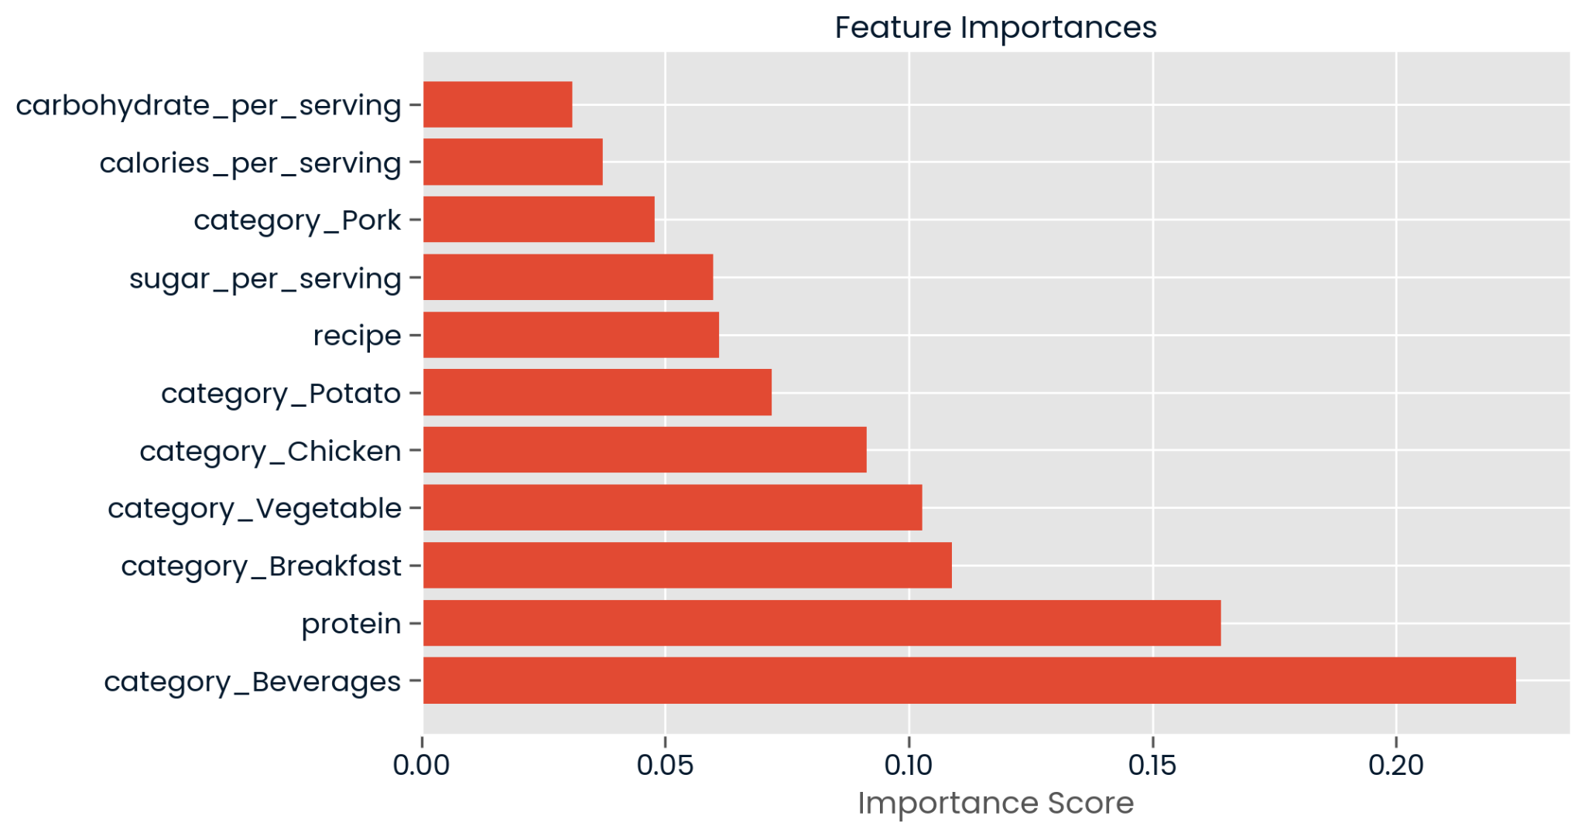
Recursive Feature Elimination
Use RFE to select most
relevant features.
Uses a Random Forest Model as estimators to
select the features to reduce dimensionality.
Notes:
Boxplots for high_traffic data and low_traffic data are very similar. -> not good indicators

Slide 18
Random Forest Classifier Model
Random Forest chosen as they are resistant to noise and outliers, and manage high-dimensional datasets effectively.
The model achieved:
- precision: 82.3%
- accuracy: 81.0%

Slide 19
Comparison Model
Logistic Regression chosen because it is efficient and well-suited for binary classification, while Random Forest can be difficult to understand and computationally complex.
The model achieved:
- precision: 82.7%
- accuracy: 78.2%

Slide 20
Results
From a business perspective, the Random Forest model outperforms the Linear Regression.
This is due to the higher accuracy with 82% being the only model which achieved the requirement of the products team.
Additionally, the precision between the models were similar with a difference of 0.4%.

Slide 21
Business Recommendations
Recommendation 1
Recommendation 2
Recommendation 3
Continuous monitoring and retraining the model:
- Ensures predictions remain relevant and accurate.
- Prioritise precision and accuracy while retraining
Creating New Features:
- Price per meal
- feedback from customers for each recipe
Increase the requirement for recipe to be high_traffic:
- Currently, if a recipe on the homepage increases traffic by 40%, it is tagged as high_traffic.
- Increase, this to select better recipes to feature on the homepage.

